Slide 1

Foundations of Entrepreneurship
Lean Startups - Value Proposition
Lecture Note # 13
04.02.2021

Slide 2
Product adoption curve
Crossing the chasm
How change is accelerating.
Traditional linear process and lean process of product development
What is minimum viable product?
How to make minimum viable product?
Example of minimum viable product

Slide 3
Value Proposition
The ‘value proposition’ is a bundle of benefits that a venture offers to its customers for which they would prefer the product or service of a venture over those of the competitors.

Slide 4
Leaders in respective segment, educated and knowledgeable, ok with risk.
Socially active, take calculated risk, need a lot of validation to trust a new product.
Look for validation and revalidation, concerned for value for money. Averse to new experiment.
Moore, G. A., & McKenna, R. (1999). Crossing the chasm.
Adventuresome, usually highly educated, inquisitive, innovative mind, risk takers.
Complacent, averse to try lesser known product, risk averse.
Innovator
2.5%
Early Adopters
13.5%
Early Majority
34%
Late Majority
34%
Laggards 16%
Product Adoption Curve
Types of consumers from new product adoption perspective
Notes:
Geoffrey moore

Slide 5
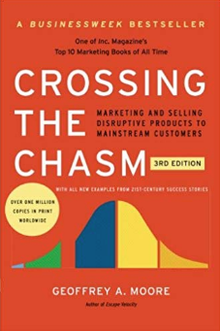
Leaders in respective segment, educated and knowledgeable, ok with risk.
Socially active, take calculated risk, need a lot of validation to trust a new product.
Look for validation and revalidation, concerned for value for money. Averse to new experiment.
Geofrey Moore: Crossing the chasm.
Adventuresome, usually highly educated, inquisitive, innovative mind, risk takers.
Complacent, averse to try lesser known product, risk averse.
Innovator
2.5%
Early Adopters
13.5%
Early Majority
34%
Late Majority
34%
Laggards 16%
Product Adoption Curve
Types of consumers from new product adoption perspective
Notes:
Geoffrey moore

Slide 6
Crossing the Chasm
Moore's concept is about diffusion of innovation and is essential element of tech entrepreneurship.
Early adopters of a product are mostly technology enthusiasts and visionaries and the early majority are the pragmatists. The stimulation does not work for them. So, there exists a chasm.
Visionaries and pragmatists have different expectations.
Techniques to successfully cross the "chasm”:
Plan the growth much ahead, prepare to put in place the required infrastructure including manpower, deep understanding of the product concept, position, build marketing strategy, choose the most appropriate distribution channel and price attractively.

Slide 7
Things are changing too fast. Survival is getting more difficult by the day.

Slide 8
Change Itself Is Accelerating: Trends Driving Market Turbulence
The dual transformation through digital disruption in retail.
The rising dominance of digital technology platforms continues to shift market value in a big way.
Disruptive change through business model innovation across industries. [Trivago, Ola, Byju’s, Paytm]
Cleantech and the downward pressure on energy prices has created new winners and losers in some of the world’s biggest industries.
The rapid explosion of private “decacorn” companies signals accelerating turbulence in the years ahead.

Slide 9
Changing Perspectives
Shareholders demand “best-in-class” performance
Intellectual capital is dominant
Innovation is rapid
Globalization is driving prices down
Customers are fickle
Investors and regulators are demanding higher ethical standard
Uncertainty
Shareholders’ demanded incremental improvements
Financial capital is dominant
Innovation was steady
Prices reflected costs
Customers were loyal
Investors and regulators ignored ethical standards
1960
2030

Slide 10
Life Span of S&P500 Companies Reduced from 61 Years in 1958 to just 18 Years in 2017

Slide 11
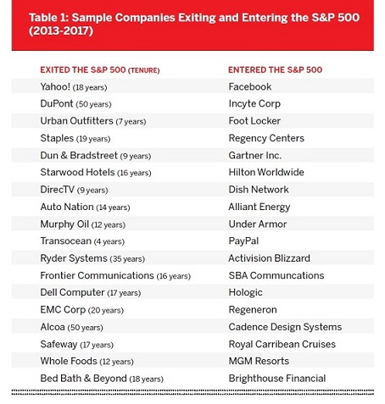
Over the past five years alone, the companies that have been displaced from the S&P list include many iconic corporations
https://www.innosight.com/insight/creative-destruction/
Notes:
Facebook founded in 2004, Paypal in 1998

Slide 12
Agrarian
Industrial
10,000
200+
5,000,000,000 - five billion years
240,000
Paleolithic era:
Hunter gatherer
Beginning of the solar system
Agrarian
Our universe has been expanding starting from 5 billion years ago. And it has been expanding faster and faster ever since.
Industrial
A diﬀerent kind of acceleration has been happening here on earth. For humans, acceleration means that the rate and scale of cultural and technological changes have been increasing.

Slide 13
Britain by the early 18th century came to possess the combination of social needs and social resources that provided the necessary preconditions of commercially successful innovation and a social system capable of sustaining and institutionalizing the processes of rapid technological change once they had started.
Steam engine - In 1765 James Watt greatly improved the Newcomen engine by adding a separate condenser to avoid heating and cooling the cylinder with each stroke. But became mainstream technology in early 1800s. First cotton ginning machine emerged during 1760s.
Windmill in early 1800s.
Benjamin Franklin of Pennsylvania, Alessandro Volta of the University of Pavia, Italy, and Michael Faraday of Britain 1810-20. But gained the present shape only at the turn of the century.
Internal combustion engine: German inventor Nikolaus Otto in 1878 improved the gas engine & it became a commercial success.
Electricity - German inventor Nikolaus Otto in 1878 that the gas engine became a commercial success.
Gottlieb Daimler and Carl Benz equipped the first motorcycle and the first motorcar respectively with engines of their own design in 1885. By the end of the 19th century, the internal-combustion engine was challenging the steam engine in many industrial and transport applications.
Electronics’ history began with the invention of vacuum diode by J.A. Fleming, in 1897
The word electronics began to be used in the 1940s.
The electronics industry was revolutionized by the inventions of the first transistor in 1948, the integrated circuit chip in 1959, and the silicon MOSFET (metal-oxide-semiconductor field-effect transistor) in 1959.

Slide 14
may
1990 | World Wide Web
1991 | First hydrogen fuel cell
1992 | Digital cell phone
1995 | DVDs
1997 | Toyota hybrid car
1998 | HD TV
2000 | Nano-Textile fabrics
2001 | Artificial heart & lever
2004 | Facebook
2005 | YouTube
2007 | High efficiency in solar cells
2010 | iPad
Autonomous vehicle, human traveling and settling down in other planets, Hyperautomation, blockchain, AI security, distributed cloud and autonomous things drive disruption, scientists could augment the brain to increase memory storage, or implant a chip to decode neural patterns. Exoskeletons may become a standard uniform for autoworkers, enabling them to lift superhuman weights. Doctors may implant sensors to track how drugs travel inside a body. Technology is now on the cusp of moving beyond augmentation that replaces a human capability and into augmentation that creates superhuman capabilities. .

Slide 15
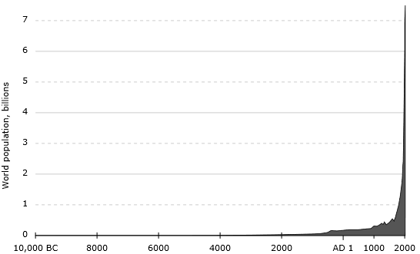
World Population: Source - Wikipedia

Slide 16
David Chrisman wrote in his book Maps of Time that it might not be an exaggeration to claim that “more change has occurred in the 20th century than in all earlier periods of human history.”
Do you think that the present century will achieve something similar? If yes, almost everything that you are part of today may not remain relevant at the turn of the century!
Why this analogy is important? Because our traditional understanding of business and career may not hold for long and we should expect change to manifest faster. So, constantly update with new knowledge to remain relevant.

Slide 17
It is absolutely unaffordable to spend years in developing a product.
It would become obsolete or irrelevant by the time it is ready.
Quick validation, redesign and rebuilding based on learning is the answer.
Intugine - smart ring called Nimble. The company has now been revolutionizing the logistics sector of India, which is still at its nascent stage as compared to its foreign counterparts.

Slide 18
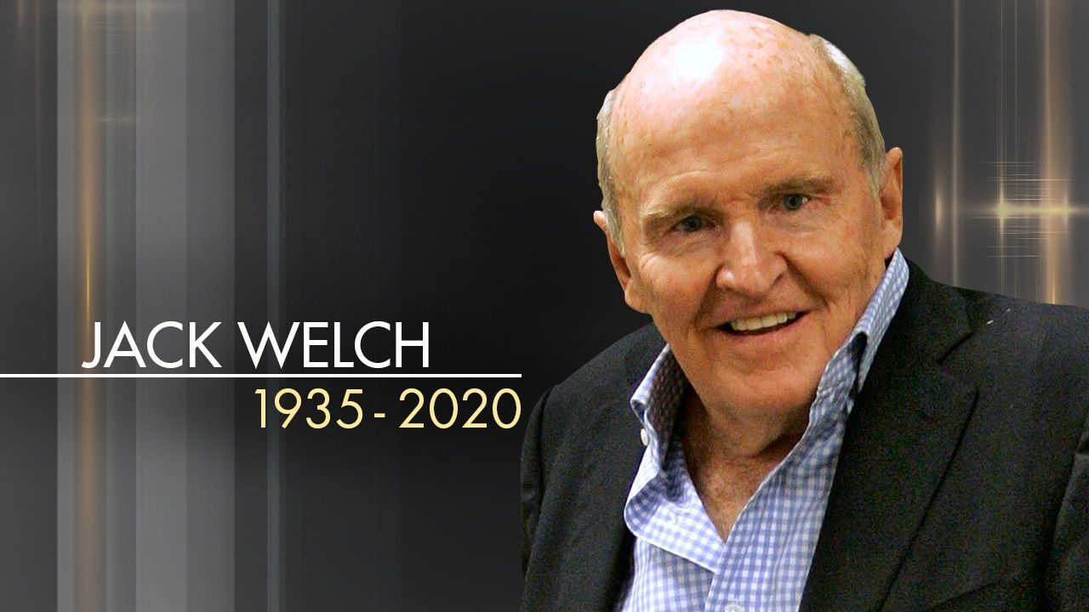
“If the rate of change on the outside exceeds the rate of the change on the inside, the end is near” – Jack Welch
The quotation has been acquiring increasing significance with each passing day because of the continuing rapid pace of change in technologies.
Reducing product development lifecycle and ensuring that customers would buy what you produce is central to success.
Lean product development method that applies customer validation process at every stage of product development is an answer.
Notes:
John Francis Welch Jr. was an American business executive, chemical engineer, and writer. He was Chairman and CEO of General Electric between 1981 and 2001. When he retired from GE he received a severance payment of $417 million, the largest such payment in business history. Read about the entrepreneurial changes he brought in GE that saw the market value GE going up from a $12 billion to $410 billion.

Slide 19
Waterfall Approach of Product Development
Requirements
Product requirement document
Design
Software architecture
Implementation
Software
Verification
Maintenance
Linear Process

Slide 20
Waterfall Model
Sales
Build
Build
Build
Build
Build
Time
Resources, Risk & ₹
Time
Release and Validate

Slide 21
Customer Validation
Validation
Sales
Build
Build
Build
Build
Build
Validation
Validation
Time
Validation
Resources, Risk & ₹
Customers
Validated Learning
Time
Release and Validate

Slide 22
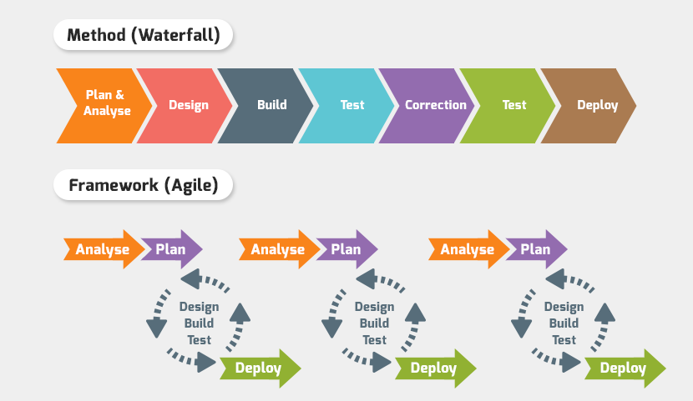
Waterfall Method: Linear process of product development
Plan & analyze
Design
Build
Test
Correct
Test
Deploy
Agile Framework: Non-linear process
Build
Test
Deploy
Learn
Design
Build
Test
Deploy
Learn
Design
Build
Test
Deploy
Learn
Design
Analyze
Plan
Analyze
Plan
Deploy/ Launch
Analyze
Plan

Slide 23
Agile System (build, measure, learn cycle)
An enabling factor in an agile manufacturer is that it allows the marketers, the production personnel and the designers to share a common source of information so that any correction in product can originate from the design itself.
A small initial problems may have larger downstream effects. It is a general proposition of manufacturing that the cost of correcting quality issues increases as the problem moves downstream.
It is cheaper to correct quality problems at the earliest possible point in the process.

Slide 24
Lean Concept
Define the problem as completely as possible.
Build the MVP with the key features that define the value proposition or product differentiation.
Eliminate all features that you think customers may not attribute value. Cut cost.
Eliminate waste in all possible ways.
Try charging the early customers. That is better validation and keep the cash flowing.

Slide 25
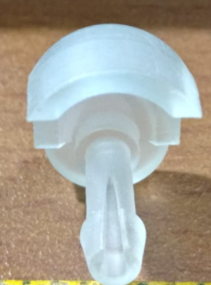
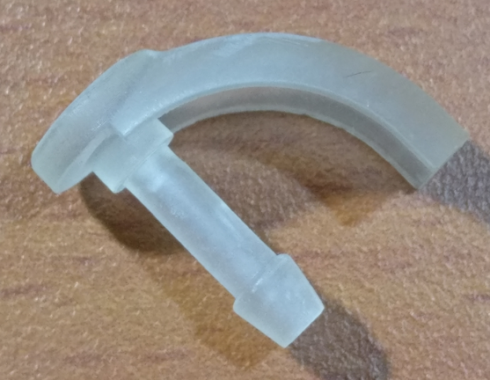
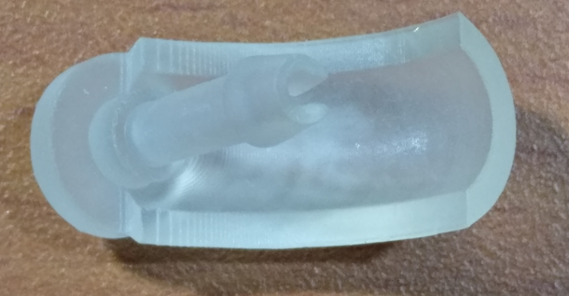
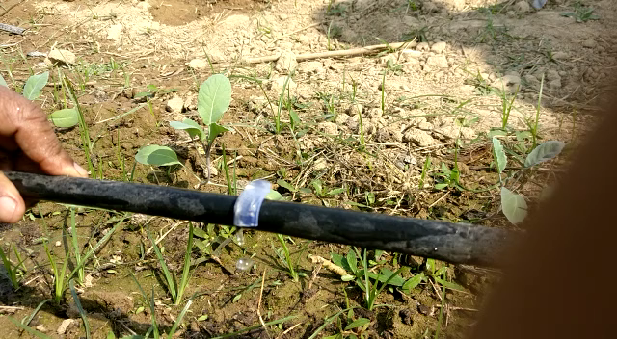

Slide 26
The Lean Start-up Process
Identify a suitable business model around a compelling pain (people are crying for a better solution).
Identify essential components for customer to appreciate.
Build a Minimum Viable Product (MVP).
An (MVP) is a product with just enough features to give the customers the sense of value proposition. It helps early customers evaluate the core functionalities and to provide meaningful feedback for future product development.
Validate your hypothesis and thus the business model.
Use the data and learning to repeat the process.
Add more features and reduce some and repeat the process.
Optimize and avoid waste.
Gather data, learn, refine

Slide 27
Lean and Agile
Lean recommends elimination of waste of all kinds of resources and waste is defined as the use of that part of resources, which does not add incremental value to customers.
Agile requires processes, tools and training so as to quickly and economically respond to customers’ needs and market changes.
Applying both Lean and Agile can ensure better success of business.

Slide 28
Lean Startup
Eric Reis seems to have combined the idea of elimination of wastes in lean manufacturing with the validated learning of Agile method, and expounded the Lean startup process.

Slide 29
How to Validate?
Validation is assessing the possible product-market-fit through user testing.
Validation is early test of your hypothesis.
The process, when done early, helps to make faster, informed, and de-risked decisions.
For validation of early prototype, develop Minimum Viable Product (MVP).

Slide 30
Creating the MVP
Identify the most critical feature of your product or service that would help the customers make a decision about your value proposition.
You need to understand the user stories – their pain point.
Suppose you are planning to prepare contents for school kids that would engage them in hands-on learning. The user story is that “The school does not have the infrastructure to demonstrate practical experiments for wholesome understanding of many topics.”
Prepare one module and evaluate its power to engage kids by asking them to use it.

Slide 31
Hypothetical Example
You prepare a few tools using which students can learn a small topic.
Present it to a batch of students, check their response, and evaluate levels of learning (ease) and retention.
Decide on further course of action based on the data.
You can postpone the huge investment to create content and make informed decisions.

Slide 32
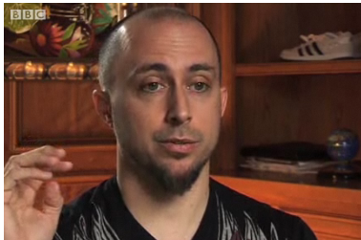
Example
After limited success in multiple startups, Nick Swinmurn wanted to start a business of online shoe selling. He was driven by his own frustration of not finding a suitable pair of shoes in couple of stores he visited.
People did not believe - customers would buy shoes without trial.
But Nick believed that people do not see what he can see.
His hypothesis was - people have limited choices when they visit a store.
His ‘leap of faith’ was - given a chance to choose from thousands of designs, most people would not mind buying online.
Instead of putting in place huge logistics, hiring people, buying huge number of shoes to display on his portal to start his business, Nick decided to pilot his idea through an MVP.
And he had a unique plan.

Slide 33
Traditional Process of Product Development
Epiphany, serendipity, eureka or just a problem.
Identify product to be developed based on market survey.
Frequently, the problem is faced by the entrepreneurs. Phanindra Sama of redBus. Burs to Velcro. Sticky notes.
Ideation and idea screening based on technical feasibility and market potential. Only a few ideas would eventually emerge as a marketable product.
Notes:
https://www.smartsheet.com/all-about-new-product-development-process
Annoyed with burs and stickers always getting attached to his socks and to his dog, Swiss engineer George de Mestral decided after a hike in the Alps to look at the burs in his socks under the microscope to find out why they stuck so well.

Slide 34
Traditional Process of Product Development … cont’d.
Design & Develop, Test and refine.
Check the design for manufacturability.
Cost & demand analysis, pricing, Go-to-market strategy.
Create awareness.
Launch - manufacture, distribute through distributor network or sell online.
Maintain or improve quality.

Slide 35
The strategy is to understand the pain, the product/service, the competition, and to create value proposition by evolving solution that serves the customer better than that of the competitors.
The longer it takes for the product to reach to the customers the longer is the time to know whether the product is acceptable by the customers.

Slide 36

The Lean Startup – by Eric Ries
How Today's Entrepreneurs Use Continuous Innovation to Create Radically Successful Businesses

Slide 37
The Lean Startup – by Eric Ries Define
01
Lean thinking: shrinking batch sizes, just-in-time inventory & production management, and acceleration of cycle times.
Progress measure: through validated learning.
Productivity: Make things that people like and pay profitable price and do it fast and economic way.
Build-measure-learn feedback loop: instead of building based on lot of assumptions, keep adjusting with a steering wheel called build-measure-learn. Through this process we can learn if and when to make a sharp turn – a pivot.
Charge early – a paying customer is a real validation of the hypothesis and it helps the most critical element: the cash flow.
02
03
04
05

Slide 38
The Lean Startup – by Eric Ries
01
Innovation factory: Use lean startup technique and continuously create disruptive innovations.
Culture and systems: Empower people to think out of the box without risk and innovate at the speed of the experimentation system.
02

Slide 39
The Lean Startup – by Eric Ries
Learn
Experiment with two hypothesis
Value hypothesis
Growth hypothesis
Leap-of-faith assumptions
Steer
Minimizing the total time
Minimum Viable Product
Learning milestones

Slide 40
Ideas > build > product > measure > data > learn > ideas > and so on (circle)
Ideas
Build
Product
Measure
Data
Learn

Slide 41
The Lean Startup – by Eric Ries
We must always ask: what if the user doesn’t care about the design in the same way we do?

Slide 42
The Lean Startup – by Eric Ries
Pivot and Preserve
Pivot – course correction based on learning. Pivot early if you have to. Vanity metrics prevent pivoting.
Preserve resources
Charge early

Slide 43
Useful Metrics
Actionable - when cause and effect is clearly understood.
Accessible - Understandable and measurable.
Auditable - meaningful to understand real performance, employees get insight of the output of their efforts.

Slide 44
The Lean Startup process is a way to test your hypothesis continuously, to adapt and adjust before it’s too late.
It is a scientific approach to creating and managing successful startups in an age when companies need to innovate too rapidly.

Slide 45
Long Before You Are Ready with a Product Ask These Questions
Are consumers crying for the solution you are trying to develop?
Would they prefer your solution over existing ones?
Would they buy at the price and through the channel you propose?
How prepared and capable are we to develop the solution and how soon can we do that?
Success is not developing a nice product even if it appears nice to the customers; success is developing something that customers buy.

Slide 46
Lean and Agile Process
Lean startup process derives the waste reduction ideology of the lean manufacturing and the validated learning process of Agile method.
Lean manufacturing is about cutting wastage of all resources as far as possible and continuously creating better value for customers.
In Agile process, execution moves forward with validated learning and handles uncertainty on the way.
Agile is directly in contrast with the traditional linear models such as waterfall model.

Slide 47
Vision - as espoused by Eric
A startup is a human institution designed to create a new product or a service under conditions of extreme uncertainty. Success under such scenarios requires rapid experimentation. – Eric Ries writes in his book “The Lean Startup”
The stepping stone is the Minimum Viable Product (MVP).
Minimum + Viable
Product that help users discover and evaluate the value proposition
Eric Ries, defined an MVP as that version of a new product which allows a team to collect the maximum amount of validated learning about customers with the least effort.
Minimum
Viable
MVP

Slide 48
MVP
A key premise behind the idea of MVP is that you produce a product with essential features, say a landing page with minimum features or a product with no aesthetics, that your customer can use and give you feedback.
Sometimes, just seeing what people do with on a product is much more reliable than asking people what they would do.

Slide 49
Align Pricing with Personas
The MVP helps to understand the eventual cost of the product.
Get a chance to understand affordability by target customers.
Understand the price- competitiveness.

Slide 50
Learn
Learning through failure is an integral part in a startup journey.
However, validated learning can accelerate the process of product development and help achieve success with minimum resources.
The goal is to quickly evolve a marketable product that is an absolute product-market-fit with minimum possible cost.

Slide 51
The Solution is to develop Minimum Viable Product and put it through validated learning, following the Build-Measure-Learn cycle – the lean product development process formally explained by Eric Ries in his book “The Lean Startup”.
The goal is also to discover the minimum features that customers definitely want and eliminate those they do not.

Slide 52
Charge Early
Start with a prototype of essential but minimum features.
Try charging customers early, preferably from day one.
Some early cash inflow goes a long way.
If customers are paying for the MVP, that is the real validation.

Slide 53
Summary
Understand customers’ pain and available solutions
Define existing solutions, ideate means to maximize customer value
Identify the features that add value and eliminate those that do not and eliminate waste.
On-board some customers for evaluating the early prototype.
Learn and refine to improve.
Charge early for keeping the cash flow running.

Slide 54
https://unsplash.com/s/photos/background for images
Ries, E. (2011). The lean startup: How today's entrepreneurs use continuous innovation to create radically successful businesses. Crown Books.
Book Summary: The Lean Startup By Eric Ries
Kander, Diana. All in Startup: Launching a New Idea when Everything is on the Line. John Wiley & Sons, 2014.
http://info.boardofinnovation.com/hubfs/Validation%20Guide%20compressed.pdf
Various Wikipedia pages
Moore, G. A., & McKenna, R. (1999). Crossing the chasm.

Slide 55
Thank you

